Slide 1
DRIVER OF
THE MONTH
DRIVER NAME

Slide 2
DRIVER
OF THE MONTH
DRIVER NAME
12 YEARS OF SAFE DRIVING

Slide 3
DRIVER OF
THE MONTH
DRIVER NAME

Slide 4
DRIVER OF THE MONTH
DRIVER NAME
12 YEARS
OF SAFE DRIVING

Slide 5
DRIVER OF
THE MONTH
DRIVER NAME

Slide 6
DRIVER OF
THE MONTH
DRIVER NAME

Slide 7
DRIVER OF
THE MONTH
DRIVER NAME
JANUARY

Slide 8
DRIVER OF
THE MONTH
DRIVER NAME

Slide 9
DRIVER NAME
2020

Slide 10
DRIVER NAME
2020

Slide 11
DRIVER NAME
2020

Slide 12
DRIVER NAME
2020

Slide 13
DRIVER NAME
2020

Slide 14
DRIVER NAME
2020

Slide 15
DRIVER NAME
2020

Slide 16
DRIVER NAME
2020

Slide 17
DRIVER NAME
2020

Slide 18
DRIVER NAME
2020

Slide 19
DRIVER NAME
2020

Slide 20
DRIVER NAME
2020

Slide 21
DRIVER NAME
2020

Slide 22
DRIVER
OF THE MONTH
DRIVER NAME

Slide 23
DRIVER
OF THE MONTH
DRIVER NAME

Slide 24
DRIVER
OF THE MONTH
DRIVER NAME

Slide 25
DRIVER
OF THE MONTH
DRIVER NAME

Slide 26
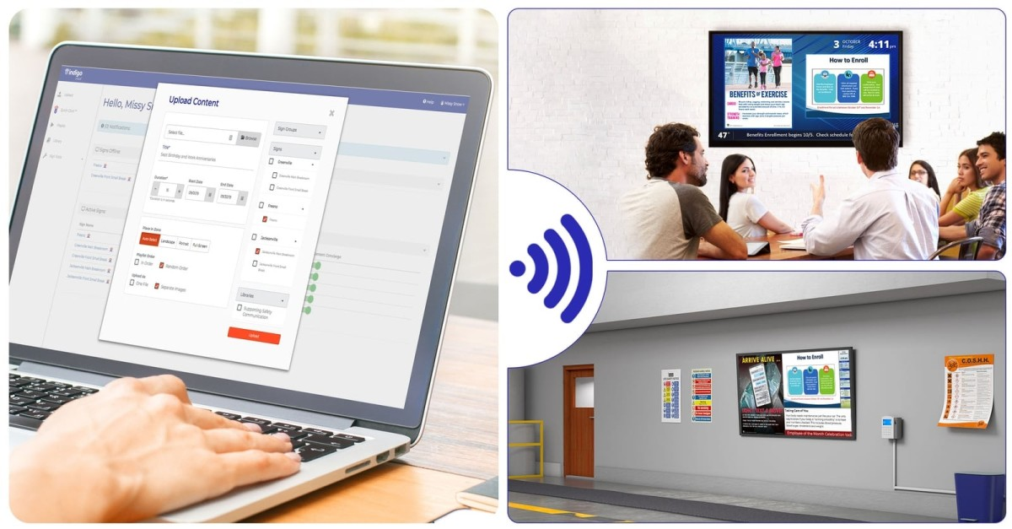
WE HOPE YOU’RE ENJOYING YOUR 150 FREE INDIGO POWERPOINT TEMPLATES!
As the leader in workplace communication for over 25 years, we understand that creating professional content isn’t always easy. But now that you’ve got that part handled with Indigo’s templates, how are you going to effectively share your creative genius with your workforce?
WITH INDIGO’S DIGITAL SIGNAGE SOFTWARE, IT ONLY TAKES A FEW CLICKS TO:
• Engage your entire company with important updates and announcements.
• Upload workplace content to your screens from your computer in seconds.
• Send meaningful content to keep your workplace safe, healthy, and secure from wherever you are.
• Keep your audience informed of current events, real-time weather and traffic conditions.
YOUR PATH TO BETTER WORKPLACE COMMUNICATION STARTS TODAY!
CLICK HERE TO SCHEDULE A DEMO
www.IndigoWorkplace.com

